Slide 1


CIA SHIELD: A Pentesting Framework for Web Security
Project by: [N.ADARRSH -24CZ0001 AND M.MURALIDHARAN - 24CZ0033]
Department of Cybersecurity

Slide 2

The Digital Frontier: Why Web Security Matters
Web Applications: The Backbone
The Threat Landscape
Rising cyberattacks continually threaten the foundational pillars of information security: Confidentiality, Integrity, and Availability (CIA).
Web apps drive modern commerce, communication, and infrastructure, making them prime targets for malicious actors.
The Need for Robust Defense
There is a critical need for a comprehensive, all-in-one penetration testing solution that addresses the CIA triad holistically.
CIA SHIELD provides an integrated, modular, and automated framework designed to elevate security testing capabilities.

Slide 3
Identifying the Gaps in Current Pentesting Tools
Fragmentation and Integration
Steep Learning Curve
Many powerful tools present significant barriers to entry for cybersecurity students or professionals new to penetration testing, complicating adoption.
Existing tools like Burp Suite, ZAP, and DVWA often operate in silos, requiring complex integration and context-switching for a full assessment.
Limited Scope
Most popular tools focus heavily on Confidentiality (e.g., data leaks, access control), but offer minimal, or less developed, testing for Integrity and Availability risks.
The current ecosystem lacks a unified, cohesive, and CIA-based penetration testing platform for comprehensive web application security analysis.

Slide 4








CIA SHIELD: The Unified Pentesting Framework
CIA-Centric Modules
Hybrid Testing Approach
Dedicated modules ensure balanced coverage across Confidentiality, Integrity, and Availability testing domains.
Seamlessly combines the efficiency of automated scanning with the depth of manual, expert-driven testing.
Intuitive Interface
Extensibility via Plugins
Provides an intuitive dashboard, guided labs, and detailed reporting suitable for both seasoned professionals and students.
Features a flexible plugin architecture allowing users to add custom tests and capabilities, adapting to emerging threats.
CIA SHIELD is designed to be the foundational tool for effective and efficient web application security assessment.

Slide 5
Development Methodology and Architecture
01
02
03
Requirement Analysis
System Design
Technology Stack
Defined core functional and security requirements, focusing on compliance with OWASP Top 10 and the CIA Triad.
Architected a modular system including data flow diagrams, UI/UX mockups, and threat modeling integration.
Built on Flask (Python) for a lightweight backend, modern HTML/CSS/JS for the frontend, utilizing robust Encryption protocols for secure operations.
04
05
Implementation
Testing & Validation
Focused on secure coding practices, implementing encrypted data storage, secure user registration, and core vulnerability test modules.
Rigorous testing ensured functional correctness, security resilience, scalability under load, and high usability scores.

Slide 6






Deep Dive: CIA SHIELD's Modular Structure
Integrity Module
Evaluates vulnerability to data tampering, checks for deserialization flaws, parameter manipulation attacks, and secure data handling.
Confidentiality Module
Focuses on testing access control mechanisms, authentication bypasses, data exposure risks, and secure communication protocols (TLS/SSL).
Availability Module
Tests DoS/DDoS resilience, implements precise rate-limiting analysis, and monitors resource consumption to prevent outages.
This unified structure ensures security teams achieve balanced coverage across the entire CIA triad, moving beyond confidentiality-only testing.

Slide 7

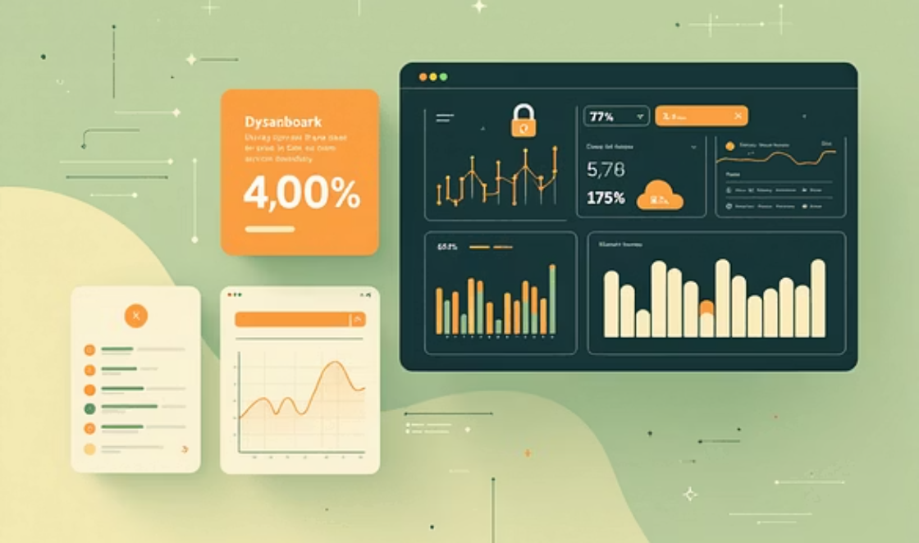

Core Features Enhancing Usability and Efficacy
Automated & Manual Scanning: Quickly identify common flaws while enabling in-depth, expert-driven analysis.
Intuitive Dashboard: Centralized view for managing projects, tracking vulnerabilities, and visualizing risk posture.
Extensible Plugin Design: Future-proofed framework allowing for easy integration of new attack vectors and custom scanners.
Comprehensive Reporting: Generate actionable reports complete with severity rankings, remediation steps, and mapping to industry standards (CVE/CWE).
Interactive Guided Labs: Safe, sandboxed environment perfect for student education and practicing ethical hacking techniques.
Ethical Testing Environment: Provides a controlled, safe space for vulnerability research and penetration testing without risk to production systems.

Slide 8
Proof of Concept: Key Implementation Results
100%
98%
Secure Authentication
Data Encryption
Implemented robust, multi-factor authentication and role-based access control (RBAC) across the platform.
Achieved high compliance in encrypting sensitive user data, both in transit and at rest, protecting confidentiality.
95%
99%
Usability Score
Scalability
User testing yielded excellent scores, confirming the interface is highly accessible for both novice and expert users.
The Flask architecture demonstrated high scalability, capable of securely managing concurrent testing sessions for multiple users.
The successfully deployed framework includes real-time audit logs and monitoring features, ensuring transparency and accountability during all testing phases.

Slide 9


Discussion: Impact and Future Trajectory
Impact & Strengths
Limitations & Future Scope
Exceptional detection capabilities for critical flaws like SQL Injection (SQLi), Cross-Site Scripting (XSS), and authentication flaws.
Current focus is primarily on web application layer testing; future releases need to incorporate network and API testing modules.
Bridging the gap: Designed to be an effective tool for cybersecurity professionals while remaining accessible for educational purposes.
Integrate AI/ML algorithms to enhance anomaly detection and automate complex exploit chain generation.
Highly adaptable and scalable architecture allows for quick response to emerging vulnerabilities and complex application landscapes.
Develop real-time, high-fidelity dashboards providing predictive risk scoring and advanced threat intelligence integration.

Slide 10




Conclusion: Securing Tomorrow, Today
Web Security is Paramount
A Holistic Platform
The escalating reliance on digital infrastructure makes continuous and thorough web security testing mandatory, not optional.
CIA SHIELD delivers a comprehensive and integrated pentesting solution, filling the gaps left by fragmented tools.
Balanced Security Focus
Dual-Purpose Tool
By focusing equally on Confidentiality, Integrity, and Availability, the framework ensures truly robust security assessments.
Successfully supports both academic education and high-stakes professional security testing environments.
CIA SHIELD is a future-ready framework poised to support the next generation of cybersecurity defense against evolving threats.

